Slide 1

Erasmus+ - Cooperation among organisations and institutions

Slide 2

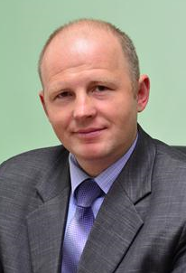
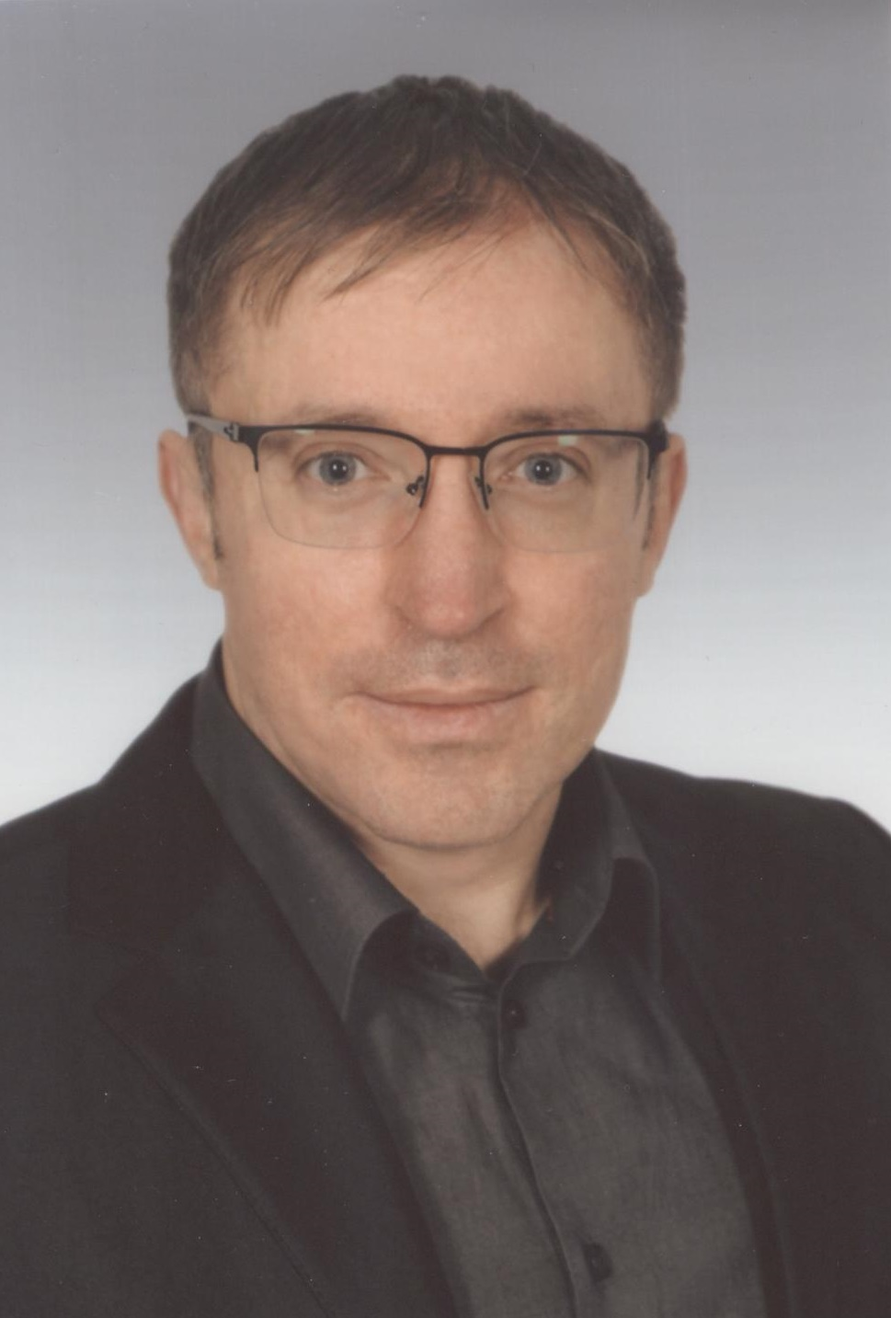
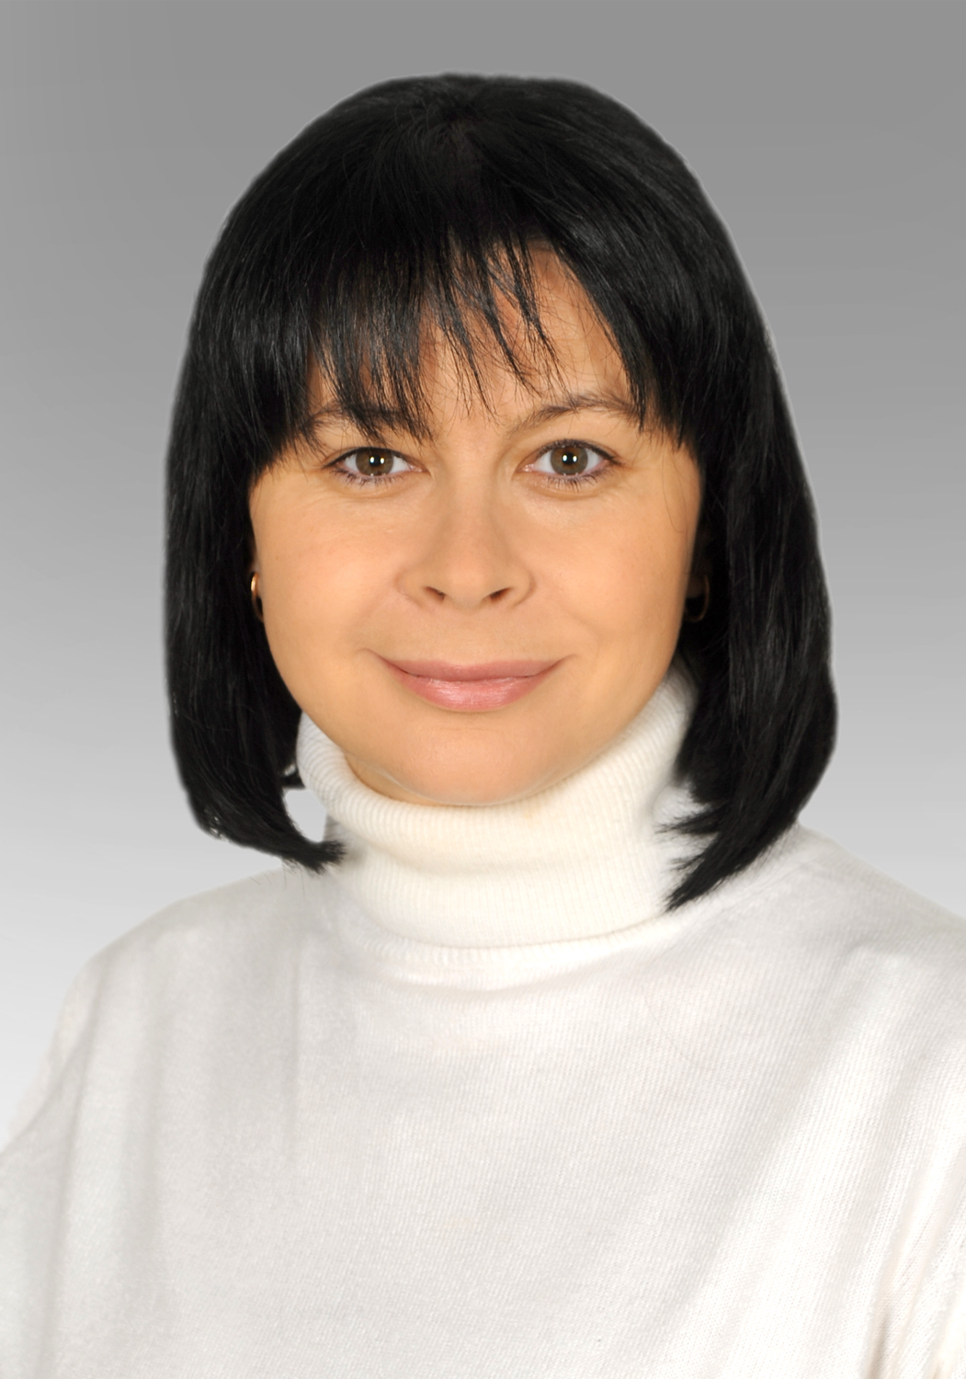
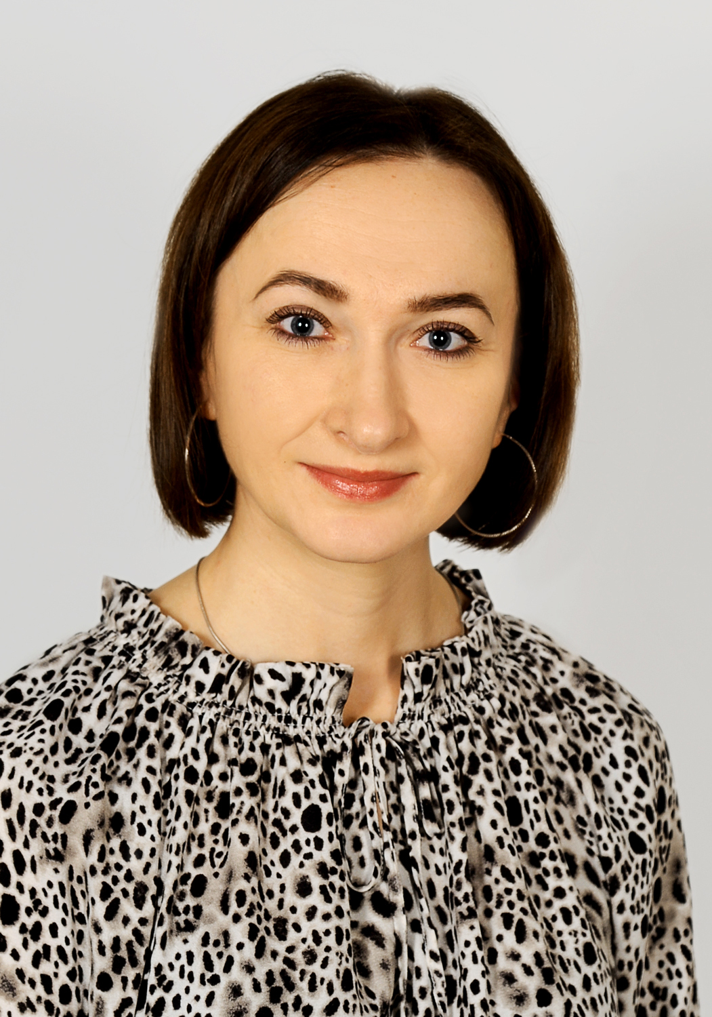
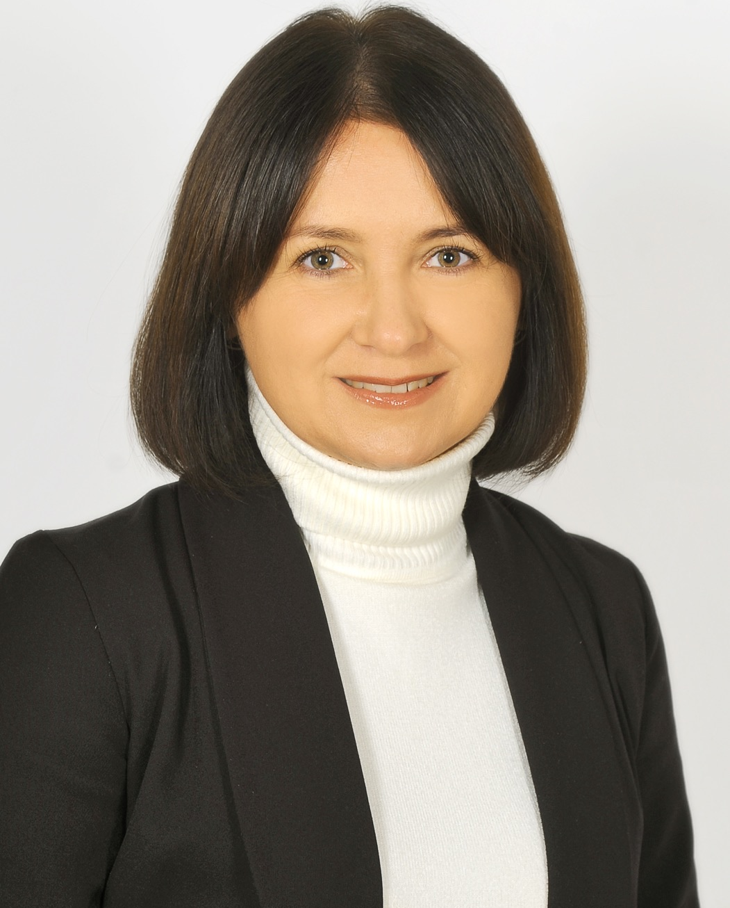
LNUVMB - Project Team - Staff members
Ihor Dvylyuk
Vice-rector for science and educational work, As. Prof. of the Department of Hygiene, Sanitation and General Veterinary Prevention named after M. V. Demchuk
Bogdan Gutyj
Head of the Department of Hygiene, Sanitation and General Veterinary Prevention named after M. V. Demchuk;
Nadiia Magrelo
As. Prof. of the Department of Hygiene, Sanitation and General Veterinary Prevention named after M. V. Demchuk
Halyna Sus
As. Prof. of the Department of Hygiene, Sanitation and General Veterinary Prevention named after M. V. Demchuk
Uliana Vus
Assistant of the Department of Hygiene, Sanitation and General Veterinary Prevention named after M. V. Demchuk

Slide 3

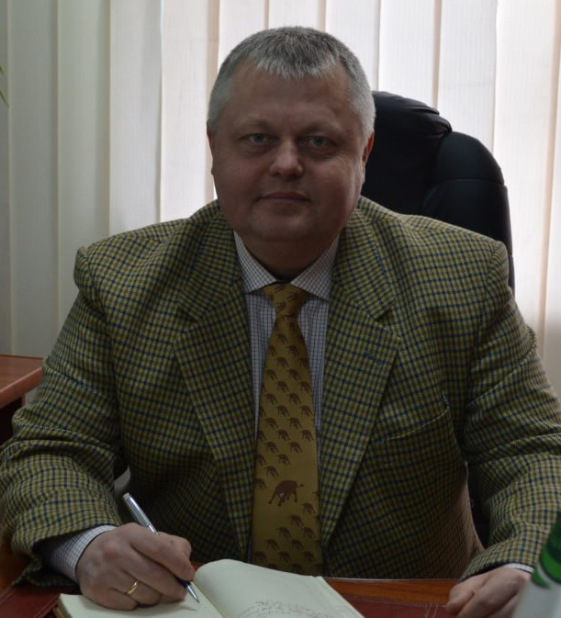
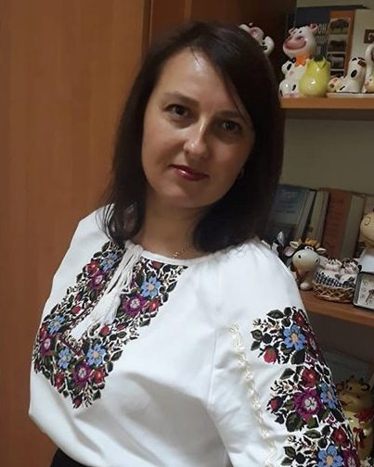
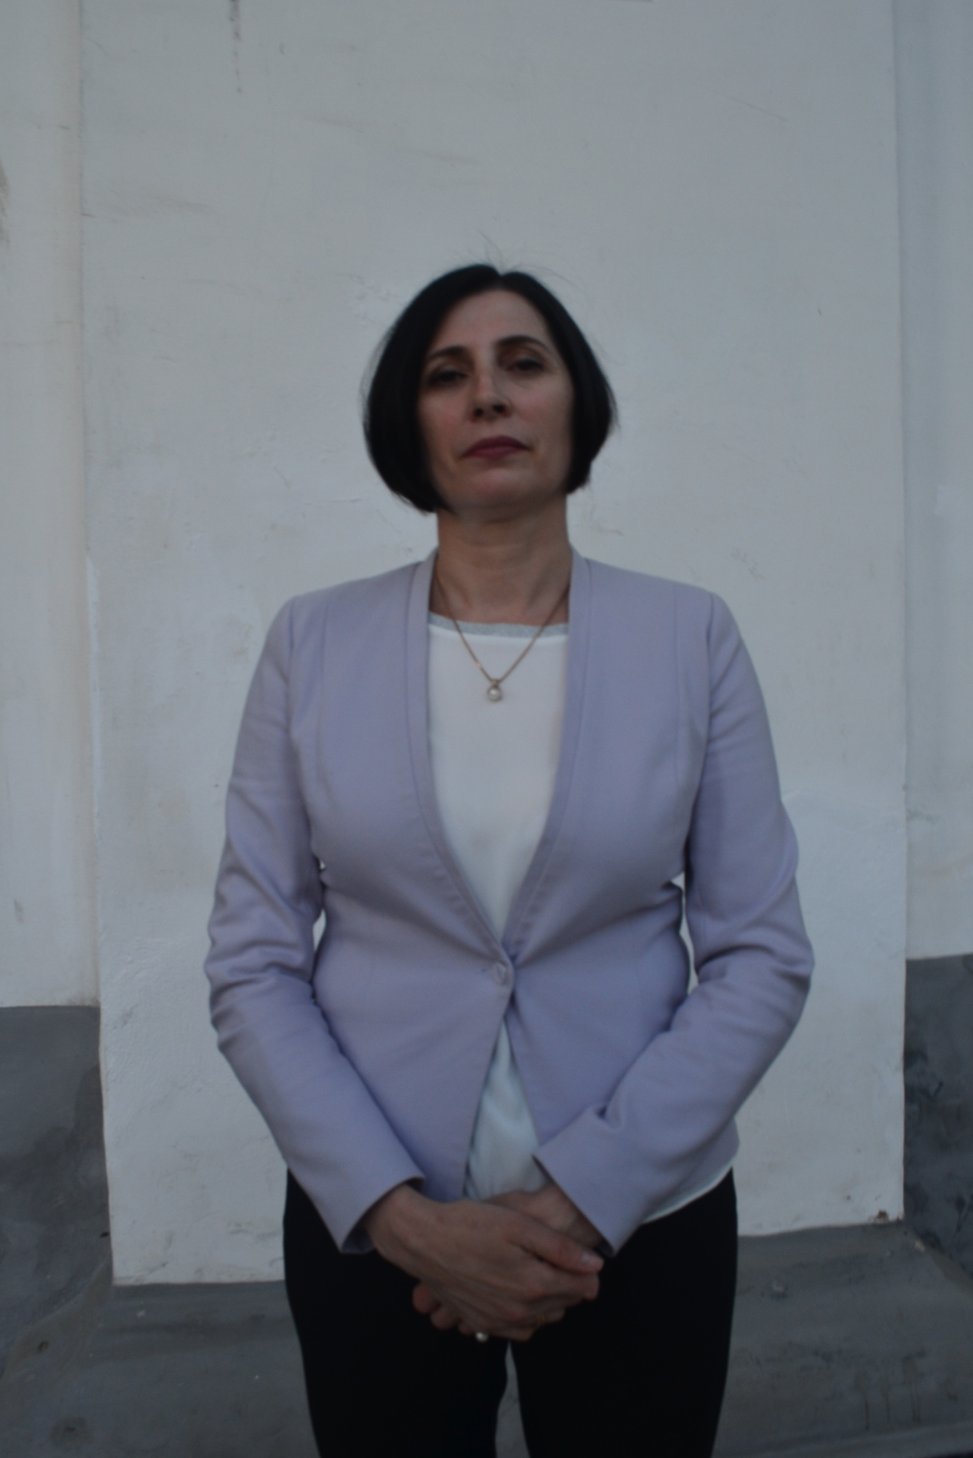
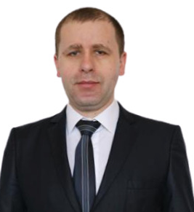
LNUVMB - Project Team - Staff members
Andriy Boyko
Administrator of the LLL center, dean of the Biological and Technological Faculty, Ph.D. in Agricultural Sciences, Associate Professor of the Department of Technology of Production and Processing of Animal Husbandry Products
Nataliya Mazur
Doctor of Agricultural Sciences, Senior Lecturer at the Department of Technology of Production and Processing of Animal Husbandry Products
Svitlana Popadyuk
Ph.D. in Agricultural Sciences, Associate Professor of the Department of Technology of Production and Processing of Animal Husbandry Products
Petro Bodnar
Ph.D. in Agricultural Sciences, Associate Professor of the Department of Genetics and Animals breeding

